Slide 1
Recursion
Lab 5 - March 12, 2024

Slide 2
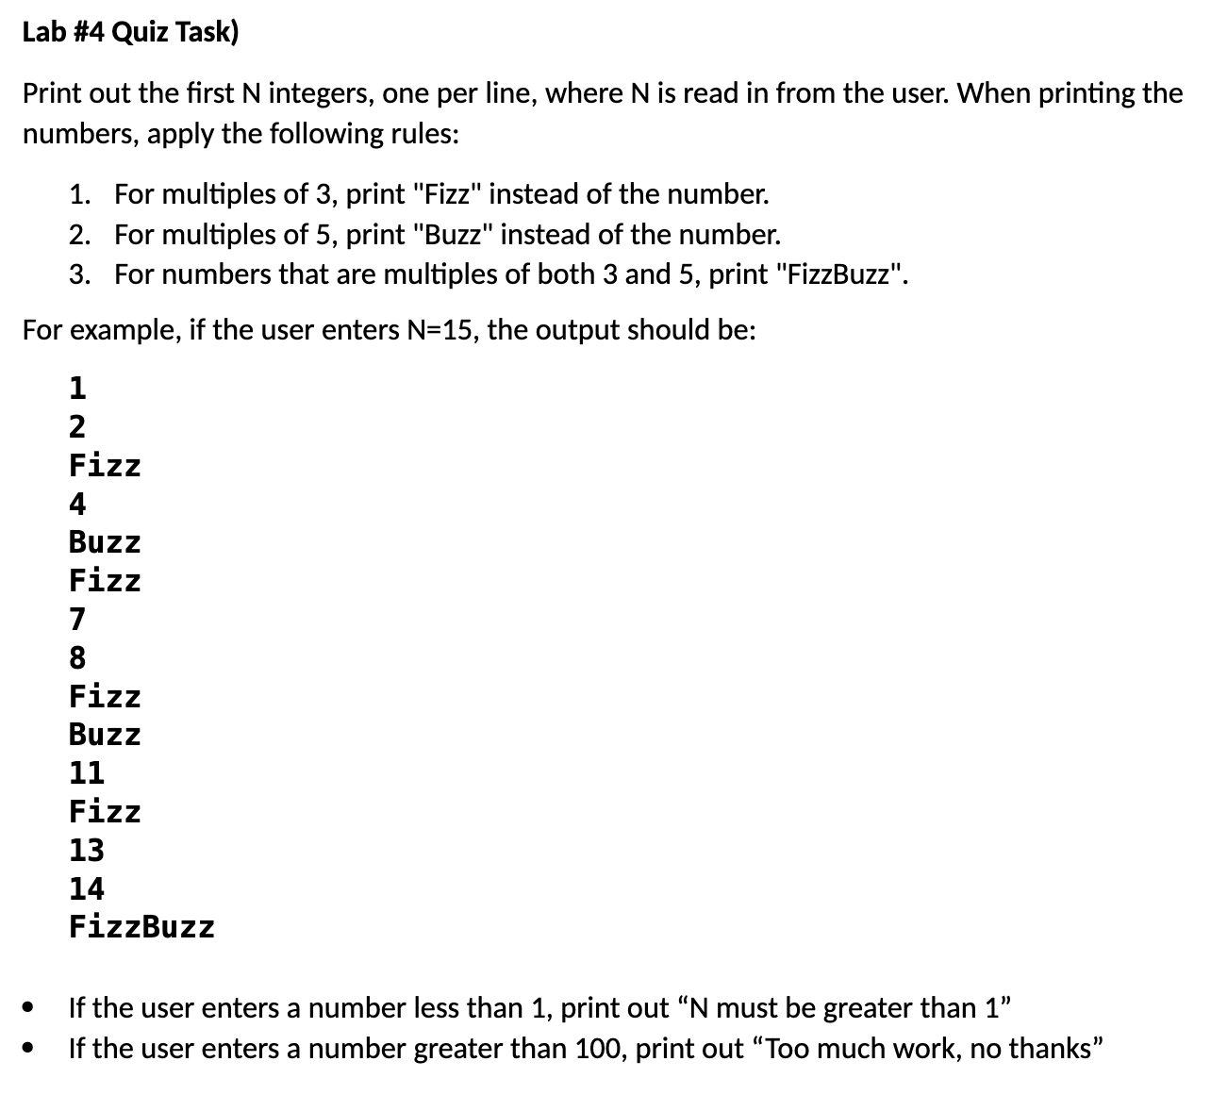
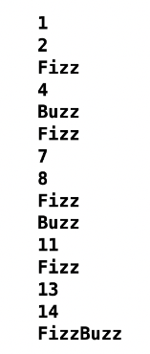
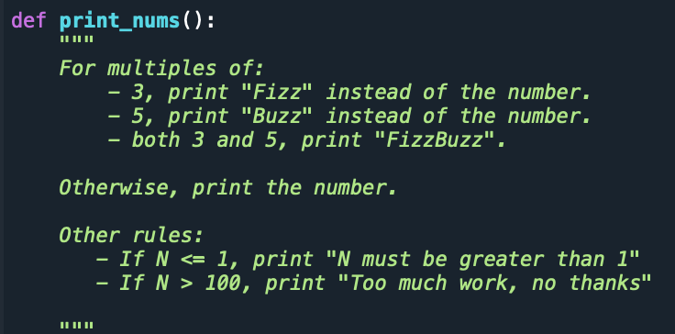
Example: N = 15

Slide 3
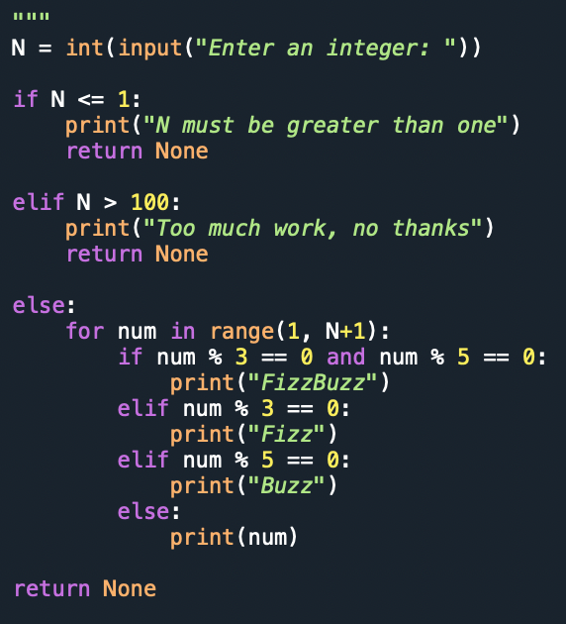
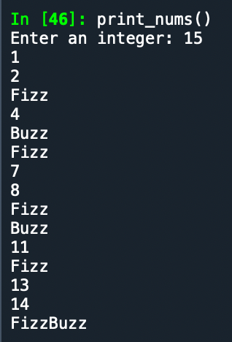
print_nums() body:
Example: N = 15
Test:

Slide 4
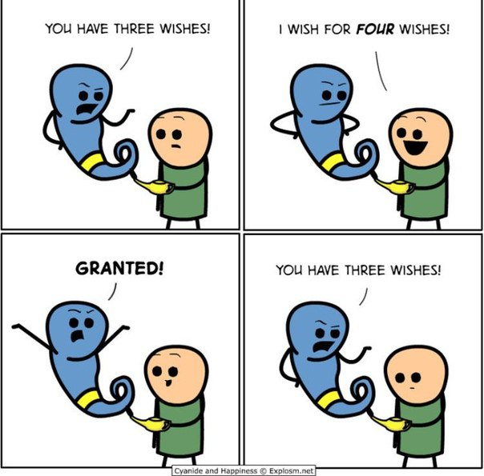
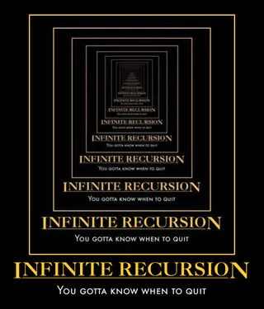
Recursion

Slide 5
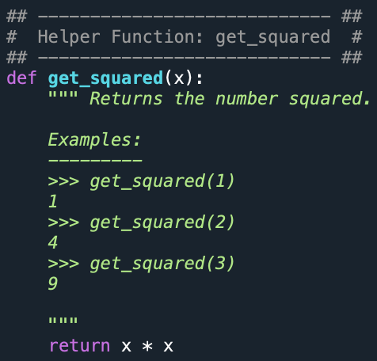
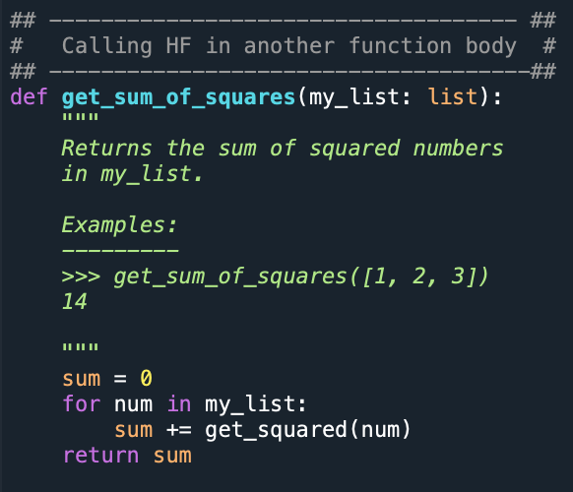

In Python, we know that a function can call other functions…

Slide 6
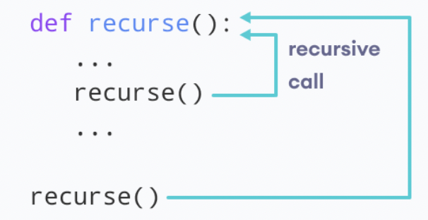
Recursion: A function can also call itself
A function that calls itself is a recursive function.
Recursion is a common mathematical concept!
We also use recursion as a programming technique
Allows us to loop through our function to reach a result.

Slide 7
A Common Example of Mathematical Recursion: The Factorial (!) Function
The factorial function (symbol: !) says to multiply all whole numbers from a specified number down to 1:
! = “The factorial of”
Examples:
4! = 4 * 3 * 2 * 1 = 24
6! = 6 * 5 * 4 * 3 * 2 * 1 =720
1! = 1
Recursive Definition: n! = n * (n-1)!

Slide 8
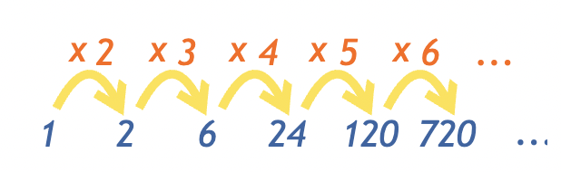
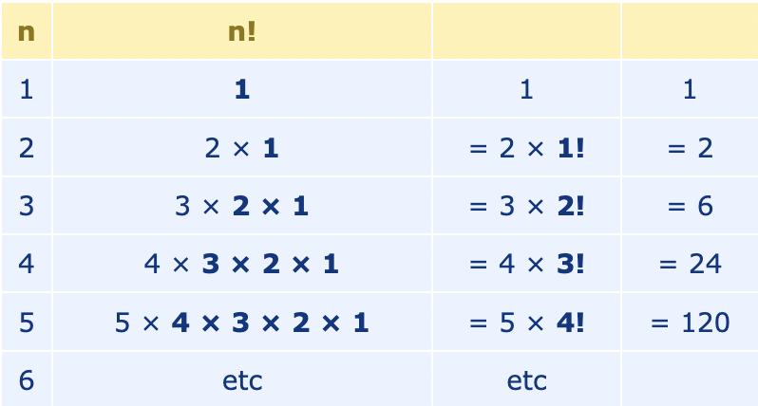
Factorials (!)
Notice how we can calculate a factorial of any given number based the factorial of the previous number:
To get:
2!, we multiply 2 by 1 to get 2.
3!, we multiply 3 by 2 to get 6
4!, we multiply 4 by 6 to get 24
5!, we multiply 5 by 24 to get 120
6!, we multiply 6 by 120 to get 720
etc.

Slide 9
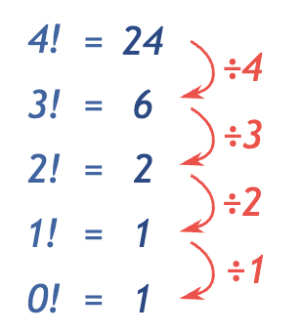
What about 0!
Mathematical convention: 0! = 1.
Make it make sense:
If we follow the recursive pattern backwards, it makes sense that we define 0! as 1.

Slide 10
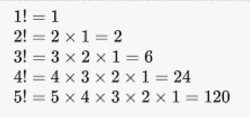
Recursive definition of factorial
Rule: “The factorial of a number will always be that number times the factorial of that number minus one”
Iterative definition: n! = n x (n-1) x (n-2) x … x 1
In recursive terms:: n! = n x (n-1)!

Slide 11
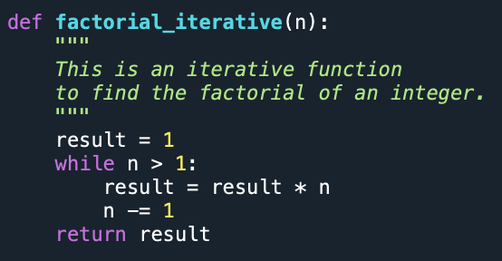
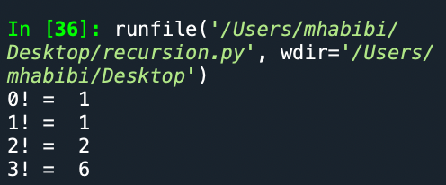
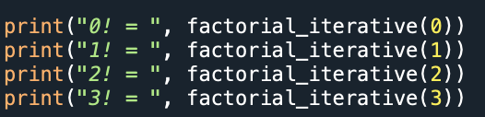
Iterative Implementation of factorials
→

Slide 12
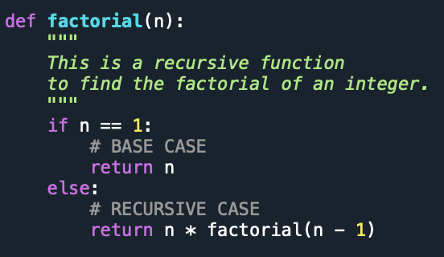
Recursive Implementation
This is a recursive function because it calls itself (i.e., in its function body)
When we call this function on a positive integer, it will recursively call itself by decreasing the number until the number reaches 1.

Slide 13


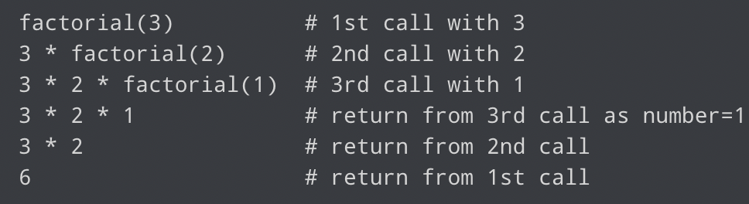
Each function multiples the number with the factorial of the number below it until it is equal to one (i.e., BASE CASE).
This recursive call can be explained in the following steps:

Slide 14
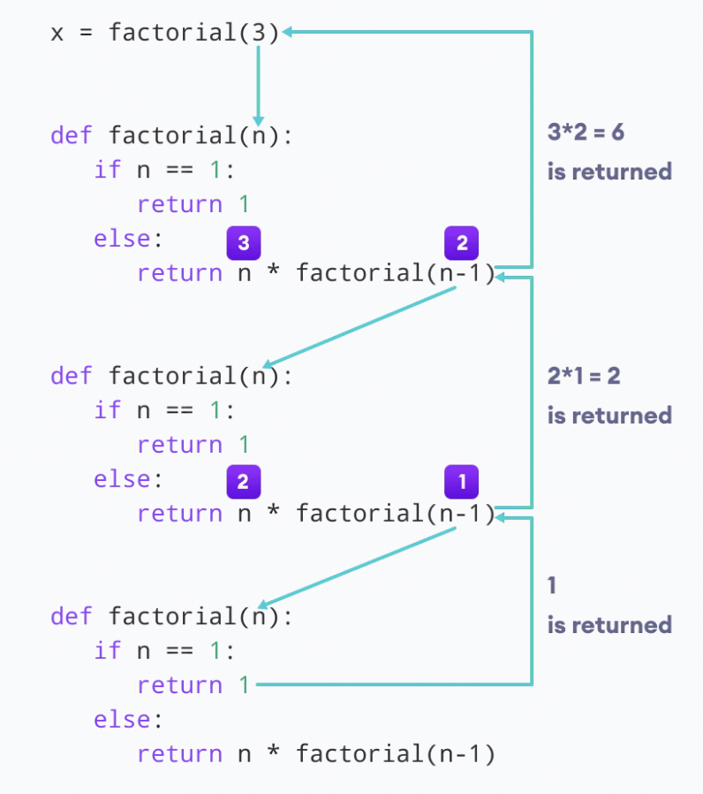
Step-by-step process: factorial(3)
Out recursion ends when the number reduces to 1. This is called the base condition.
Out recursion ends when the number reduces to 1. This is called the base condition.

Slide 15
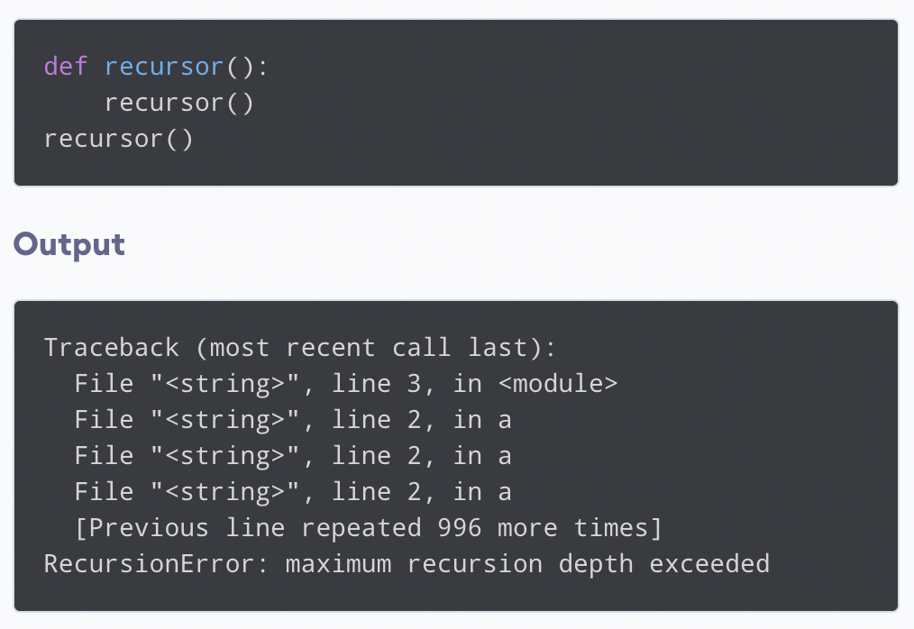
The Base condition
Every recursive function must have a base condition that stops the recursion OR ELSE the function will call itself infinitely.
By default, the maximum depth of recursion is 1000 (calling the function 1000 times). If this limit is crossed, it results in RecursionError.
Output:

